Slide 1

EARTHQUAKE DETECTION USING MACHINE LEARNING ALGORITHMS
by
AKSHAYA G
Roll No. 194G1A0505
MANOJ A
Roll No. 194G1A0557
ARAVIND B
Roll No. 204G5A0501
DEEPTHI T
Roll No. 204G5A0503
Under the guidance of
Mr. Nazeer Shaik
Assistant Professor
Assistant Professor
Department of Computer Science and Engineering
Srinivasa Ramanujan Institute of Technology
Autonomous
Rotarypuram Village, B K Samudram Mandal, Ananthapuramu – 515701.
2022-2023

Slide 2
Review - 0 Comments
Review- 0 comments
About the Data Set collection?

Slide 3
Review - 1 Comments
Review - 1 comments
Asked about how input is taken?

Slide 4

Contents
Abstract
Introduction
Literature Survey
Existing System
Proposed System
Planning and Design
Implementation
Research Paper
References

Slide 5
Abstract
An Earthquake is the sudden shaking of the surface of the earth resulting from sudden release of energy in the Lithosphere. Reliable prediction of earthquakes has numerous societal and engineering benefits. In recent years, the exponentially rising volume of seismic data has led to the development of several automatic earthquake detection algorithms through machine learning approaches. Different algorithms have been applied on earthquake detection like Decision tree, Random Forest classifier, Support vector Machine, KNeighborsClassifier.
Keywords: Machine Learning, Earthquake, Random Forest Classifier, Decision tree, Support Vector Machine, KNeighborsClassifier.

Slide 6
Introduction
Earthquakes generally occur because of plate tectonics. While it is important to understand the nonlinear dynamics of earthquake generation process. Earthquake detection is an essential area of research that deals with identifying and analysing seismic activity, which can cause significant destruction and loss of life. Traditional earthquake detection methods rely on seismometers, which can be expensive and not always reliable. However, with the advancements in machine learning, earthquake detection using machine learning algorithms has gained popularity.
Machine learning algorithms can identify patterns in large amounts of seismic data and detect seismic activity in real-time. This has the potential to improve the speed and accuracy of earthquake detection, allowing for earlier warnings and more effective disaster response. In this context, machine learning algorithms are trained on seismic data and use various techniques to detect earthquakes.

Slide 7
Literature survey
Ali G. Hafez, Ahmed Abdel Azim, M. Sami Soliman &amp; Hideki Yayama [1] have proposed a technique called P-wave picking which is one of the important steps for earthquake parameter determination. Although manual inspection of P-wave arrival timing is the most accurate method for detection but, using automated algorithm is a must to facilitate this continuous task. This algorithm generates a daily report of all events recorded by this sub-network. This algorithm can detect very small events starting from microearthquakes due to the use of multiresolution analysis (MRA) of discrete wavelet transform (DWT). Results show a high rate of successful detections of 94.6% with low false alarm rate.

Slide 8
Literature Survey
Lomax, A. Michelini and D. Josipovic’s [2] have suggested an investigation of rapid earthquake characterization using single station waveforms and a convolutional neural network. Effective early-warning, response and information dissemination for earthquake sand tsunamis require rapid characterization of an earthquake’s location, size and other parameters. This characterization is mainly provided by real-time seismogram analysis using established, rule-based, seismological procedures. With the advent of powerful machine learning tools to make predictions from large data sets.

Slide 9
Literature Survey
Omar M. Saad, Ali G. Hafez, and M. Sami Soliman [3] has proposed Deep Learning Approach for Earthquake Parameters Classification in Earthquake Early Warning System. Magnitude determination of earthquakes is a mandatory step before an earthquake early warning (EEW) system sends an alarm. Beneficiary users of EEW systems depend on how far they are located from such strong events. Therefore, determining the locations of these shakes is an important issue for the tranquillity of citizens as well. The proposed algorithm depends on a convolutional neural network (CNN) which can extract significant features from waveforms that enabled the classifier to reach a robust performance in the required earthquake parameters. The classification accuracies of the suggested approach for magnitude, origin time, depth, and location are 93.67%, 89.55%, 92.54%, and 89.50%, respectively.

Slide 10
Literature Survey
H Hang Zhang 1 2, Jun Zeng 1, Chunchi Ma 1 3, Tianbin Li 1, Yelin Deng 1, Tao Song [4] has proposed a Multi-Classification of Complex Microseismical Waveforms Using Convolutional Neural Network. In this study, a micro seismic multi-classification (MMC) model is proposed based on the short time Fourier transform (STFT) technology and convolutional neural network (CNN). The real and imaginary parts of the coefficients of micro seismic data are inputted to the proposed model to generate three classes of targets. micro seismic data recorded under different geological conditions are also tested to prove the generality of the model, and a micro seismic signal with Mw ≥ 0.2 can be detected with a high accuracy. The proposed method has great potential to be extended to the study of exploration seismology and earthquakes.

Slide 11
Literature Survey
Khawaja Asim, Abdul Basit, Francisco Martinez-Alvarez and Talat Iqbal [5] has detected Earthquake magnitude in Hindukush region using machine learning techniques.In the research, four machine learning techniques including pattern recognition neural network, recurrent neural network, random forest, and linear programming boost ensemble classifier are separately applied to model relationships between calculated seismic parameters and future earthquake occurrences. Here, several performance measures can be done with parameters and accuracy can be estimated.

Slide 12
Existing System
Neural networks are investigated for predicting the magnitude of the largest seismic event in the following month based on the analysis of eight mathematically computed parameters known as seismicity indicators.
The indicators are selected based on the Gutenberg-Richter and characteristic earthquake magnitude distribution and also on the conclusions drawn by recent earthquake prediction studies.
Since there is no known established mathematical or even empirical relationship between these indicators and the location and magnitude of a succeeding earthquake in a particular time window, the problem is modeled using three different neural networks: a feed-forward Levenberg-Marquardt backpropagation (LMBP) neural network, a recurrent neural network, and a radial basis function (RBF) neural network.
Prediction accuracies of the models are evaluated using four different statistical measures: the probability of detection, the false alarm ratio, the frequency bias, and the true skill score or R score.

Slide 13
Existing System
Drawbacks of Existed System:
The main disadvantage of using this model is large amount of data can be processed within a more spam.
The accuracy is low in this model.

Slide 14
Proposed System
In the proposed system we are using multiple machine learning algorithms like Random forest classifier, Decision tree classifier, K-Neighbours classifier and SVM(Support Vector Machine).
Random forest algorithm helps in predicting An earthquake's latitude, longitude, magnitude, and depth.
Support Vector Machine (SVM) is a classification and regression prediction tool that uses machine learning theory to maximize predictive accuracy while automatically avoiding over-fit to the data.
Decision Tree algorithm is good for signal and vibration classification.
KNN can be used as a predictive model to identify seismic events based on their similarity to previously recorded earthquakes.
The attributes like longitude, latitude, depth, cdi, mmi, sig, dmin, nst, gap are taken as the inputs.
We will get level of magnitude i.e low or high as a output.

Slide 15
Proposed System
Advantages of Proposed System:
The main advantage of using this model is large amount of data can be processed within a less spam.
The accuracy value is high.
We are able to detect magnitude level.

Slide 16
Planning
OBJECTIVE:
The main goal of this project is build a model to obtain best possible accuracy to detect whether there is the occurrence of earthquake or not.
Scope :
In the model we are going to detect whether the earthquake is going to occur or not.

Slide 17
Planning
S.No | Development Stage | Duration
1. | Domain Selection | 1 week
2. | Literature Survey and Problem Definition | 2 weeks
3. | Requirements Gathering | 1 week
4. | Design and Planning | 2 weeks
5. | Implementation | 9 weeks
6. | Testing | 3 weeks
7. | Deployment | 2 weeks
Table : Work Schedule

Slide 18
Planning
Methodology
To implement this project Iterative Model is used. It involves continuous cycle of Planning, Analysis, Implementation and Evaluation.
The Iterative Model allows the accessing earlier phases, in which the variations made respectively. The final output of the project renewed at the end of the Software Development Life Cycle (SDLC) process.

Slide 19
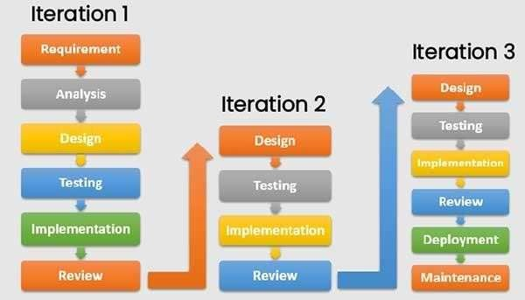
Planning
Fig : Iterative Model

Slide 20
Planning
Functional Requirements
The preprocessing techniques are being used on the data.
Streaming API is used in our system for collection of data using keyword.
Non - Functional Requirements
Usability :
This Project can be used in predicting whether the particular event is going to occur or not.

Slide 21
Planning
Performance :
This model will give good performance for feature extraction using machine learning model.
Speed
This Project the convolution neural network will detection the event occurrence quickly.

Slide 22
Planning
SYSTEM SPECIFICATION:
HARDWARE REQUIREMENTS:
System : Pentium IV 2.4 GHz.
Hard Disk : 40 GB.
Monitor : 14’ Colour Monitor.
Mouse : Optical Mouse.
Ram : 512 Mb.
SOFTWARE REQUIREMENTS:
Operating system : Windows 7 Ultimate.
Coding Language : Python.
Front-End : IDE, JUPITER NOTEBOOK.

Slide 23
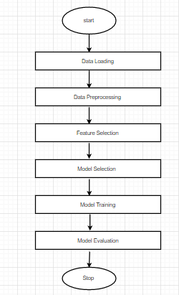
Design
Fig : The Schematic Representation of Workflow Process

Slide 24
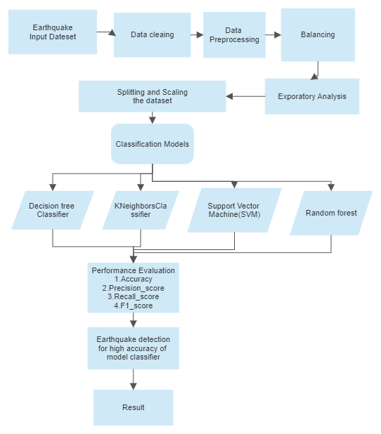
Design
Fig : Layers of CNN
Fig : Flow Chart

Slide 25
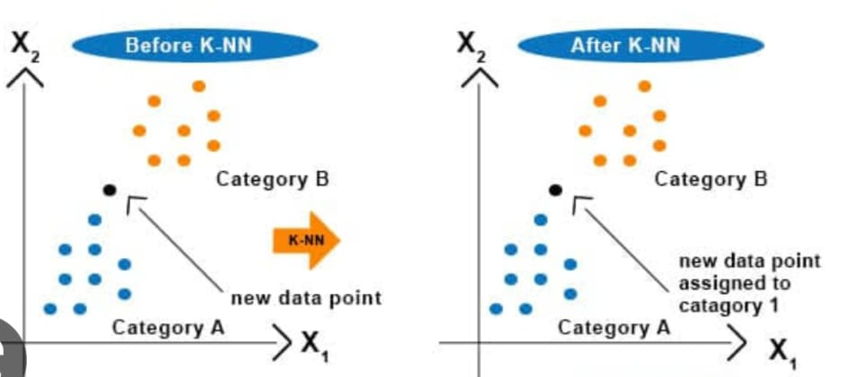
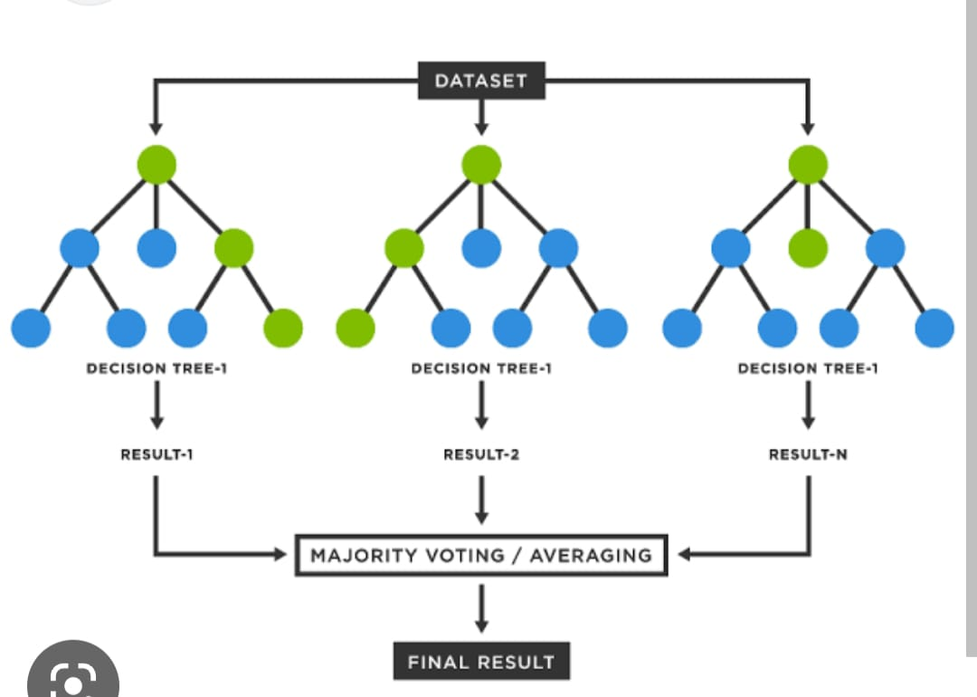
Design
Fig : Random Forest Classifier
Fig: K Nearest Neighbour

Slide 26
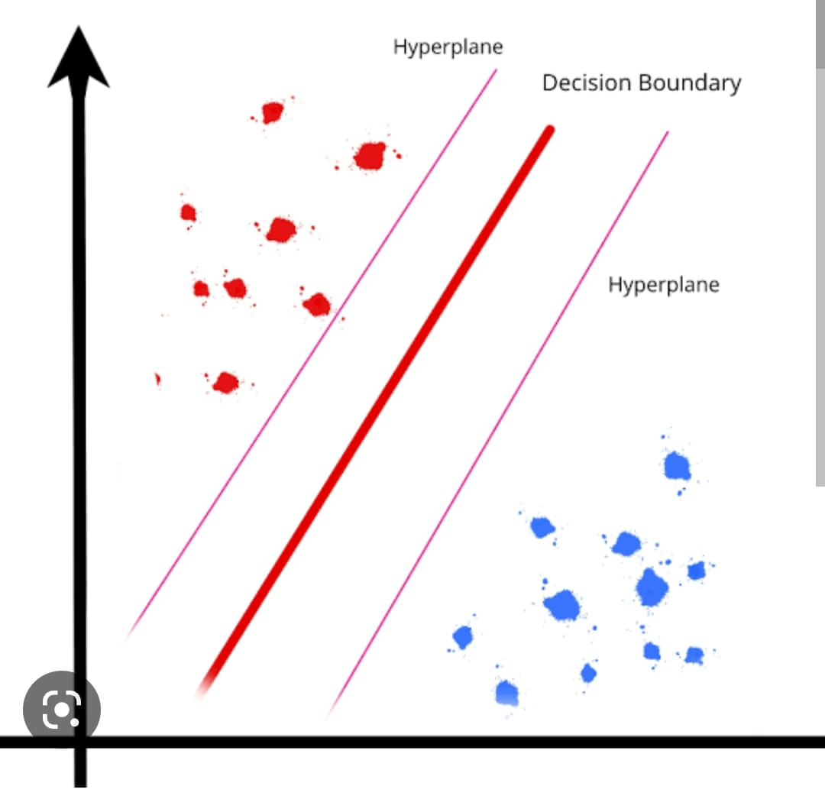
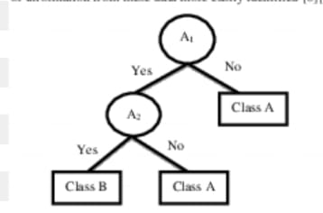
Design
Fig : Support Vector Machine
Fig : Decision Tree

Slide 27
Implementation
Libraries used for developing are as follows:
NumPy :
NumPy, which stands for Numerical Python, is a library consisting of multidimensional array objects and a collection of routines for processing those arrays. Using NumPy, mathematical and logical operations on arrays can be performed
Pandas:
Pandas is a popular Python library for data manipulation and analysis. It provides powerful tools for data manipulation, analysis, and cleaning, making it a favorite tool among data scientists, analysts, and researchers.
Matplotlib:
Matplotlib is a popular data visualization library in Python that provides a variety of plotting functions to create visualizations of data. It allows you to create a wide range of graphs and charts, including line plots, scatter plots, bar plots, histograms, and more.

Slide 28
Implementation
Scikit-learn: Scikit-learn provides a wide range of machine learning algorithms, including text classification algorithms, such as Naive Bayes, SVM, and Random Forest. It also provides tools for feature extraction and preprocessing, which are important for text classification. These are some of the machine learning models that can be imported from scikit-learn (sklearn) for classification tasks:
DecisionTreeClassifier: This is a class for building a decision tree classifier. Decision trees are a popular machine learning method used for both classification and regression problems.
KNeighborsClassifier: This is a class for building a k-nearest neighbors classifier. In this model, the k closest training samples to a new data point are used to predict its class.
SVM: This is a class for building a support vector machine (SVM) classifier. SVMs are a popular machine learning method used for both linear and nonlinear classification tasks.
RandomForestClassifier: This is a class for building a random forest classifier. A random forest is an ensemble learning method that combines multiple decision trees to improve predictive performance.

Slide 29
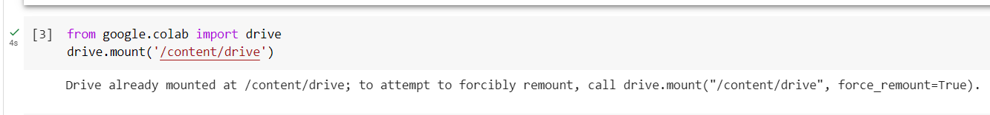
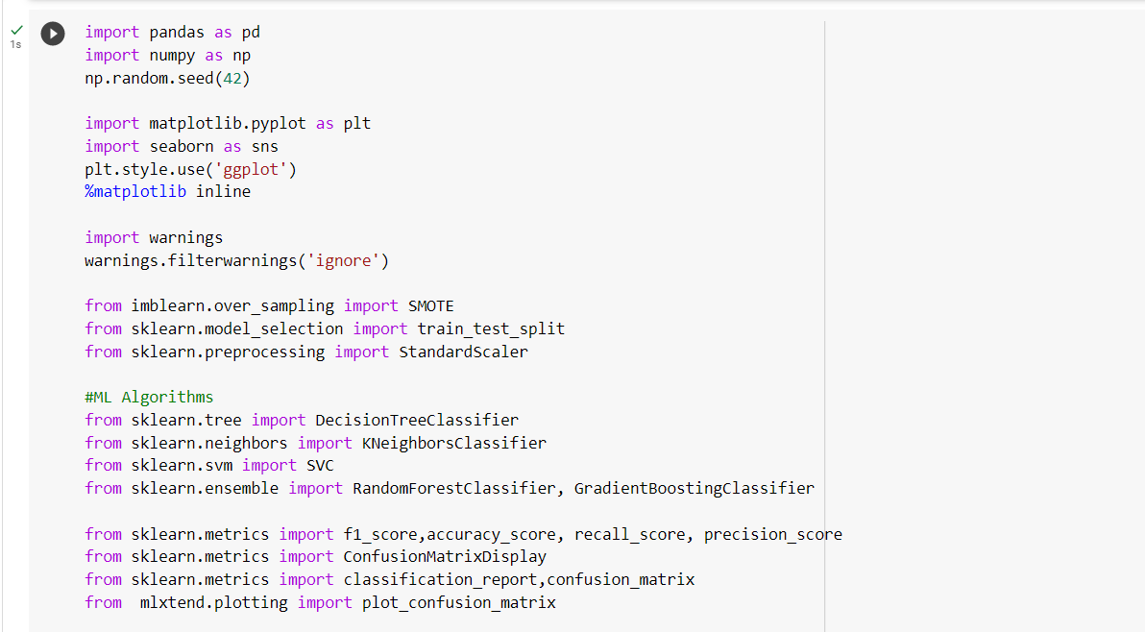
Implementation
Mounting the drive
Import necessary libraries

Slide 30
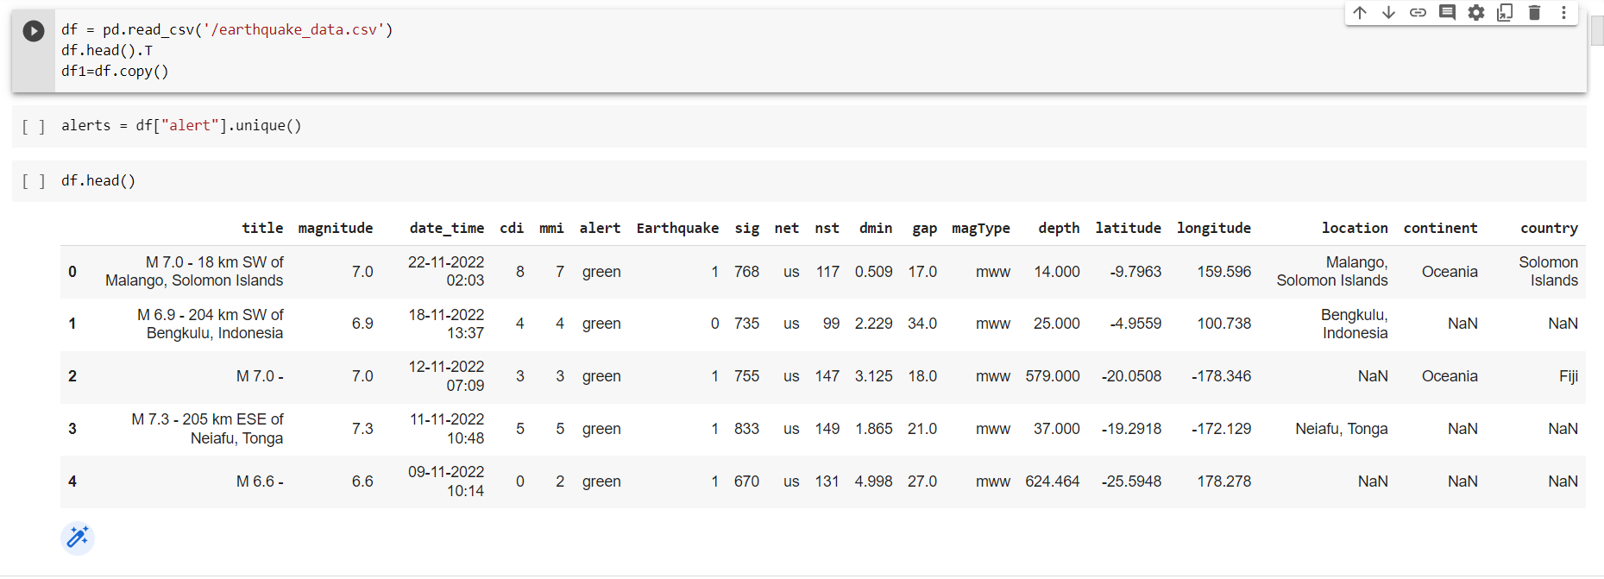
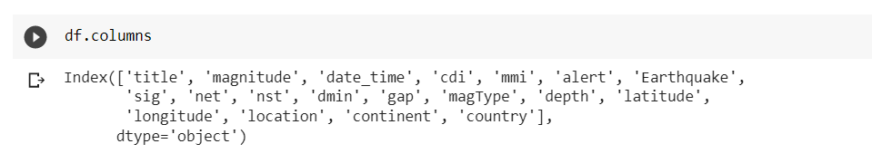
Implementation
Data understanding
Data Columns

Slide 31
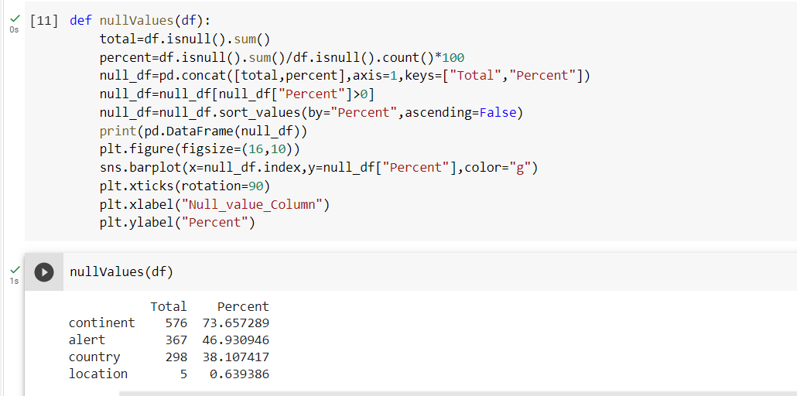
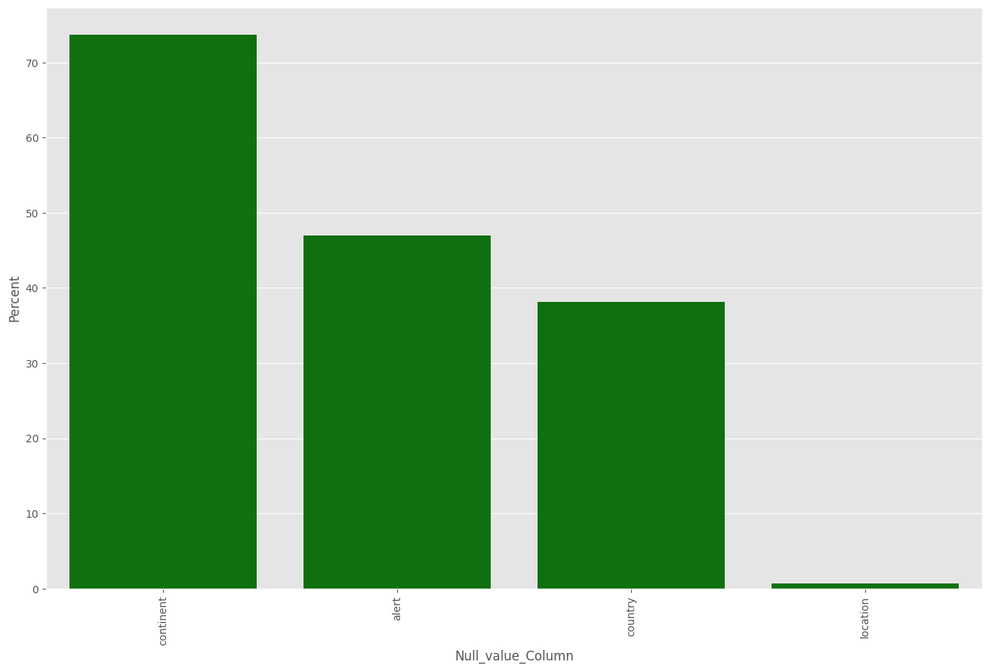
Implementation
Data Cleaning

Slide 32
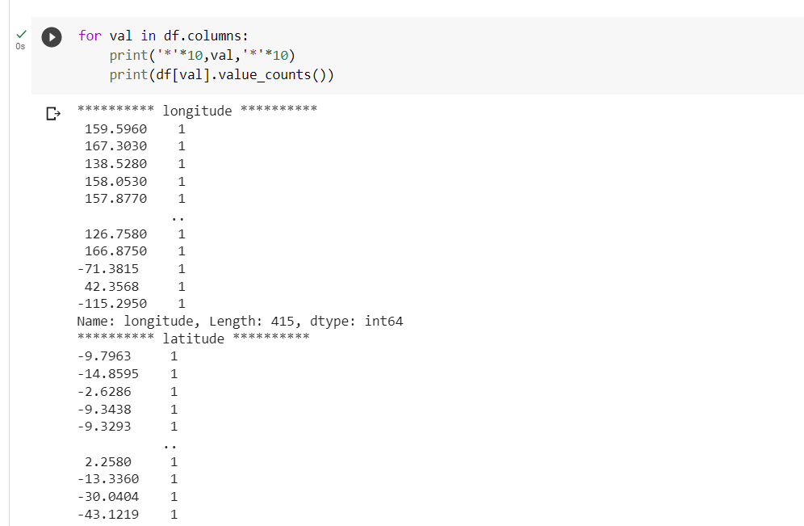
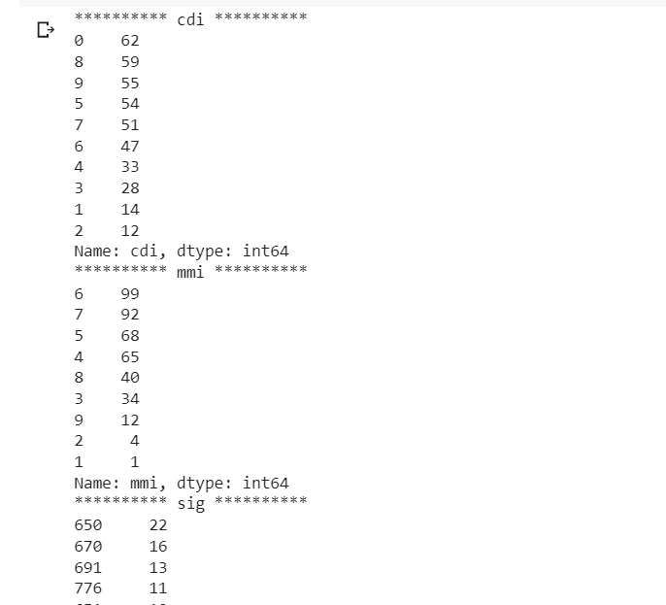
Implementation
Data Preprocessing

Slide 33
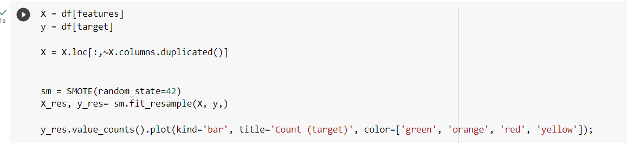
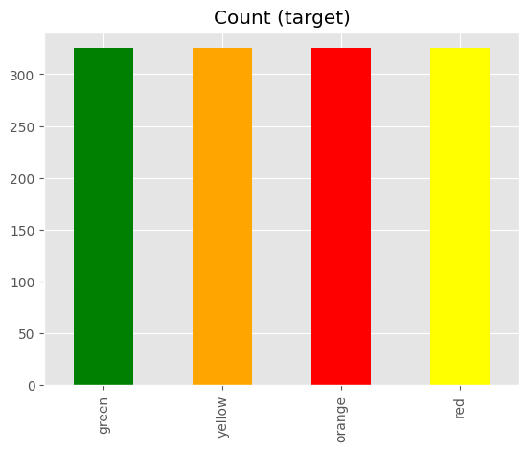
Implementation
Balanced the target

Slide 34
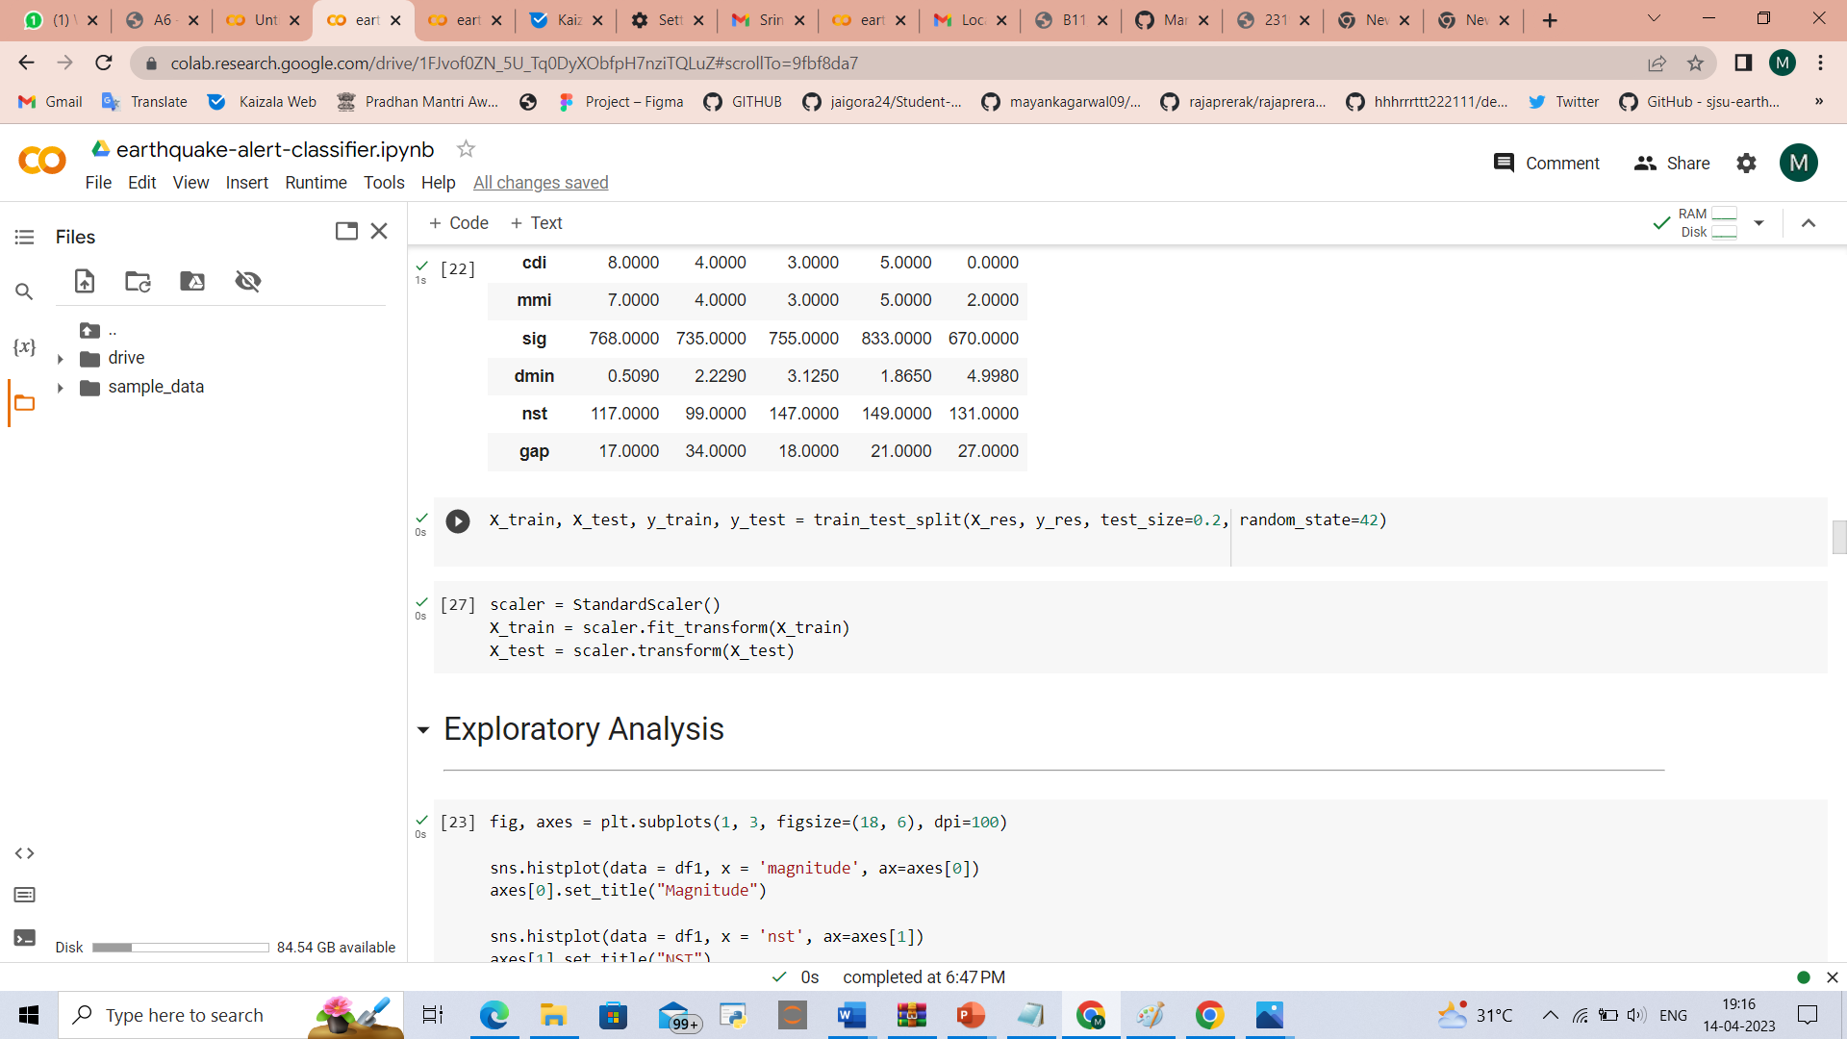
Implementation
Splitting
Scaling

Slide 35
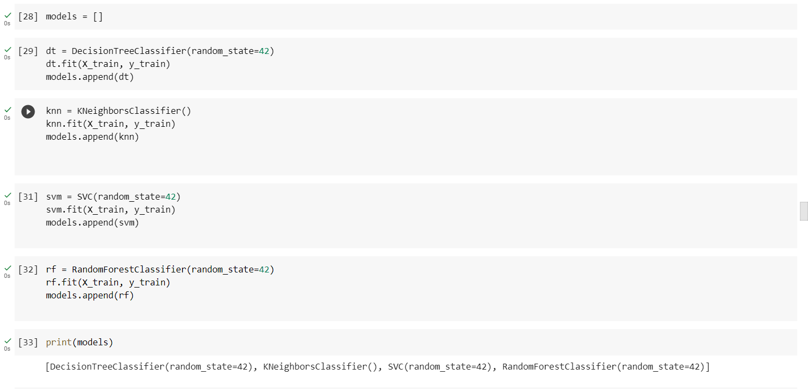
Implementation
Algorithms
Classification models --- Decision tree, kNeighbors, SVM, Random Forest

Slide 36
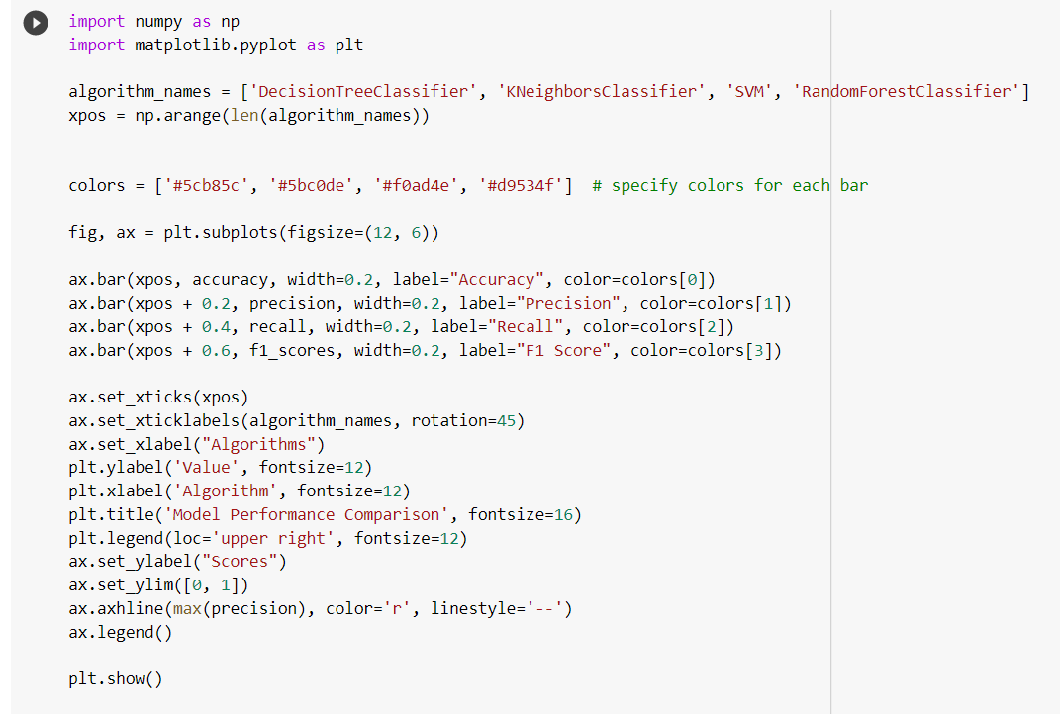
Implementation
Model performance Comparison

Slide 37
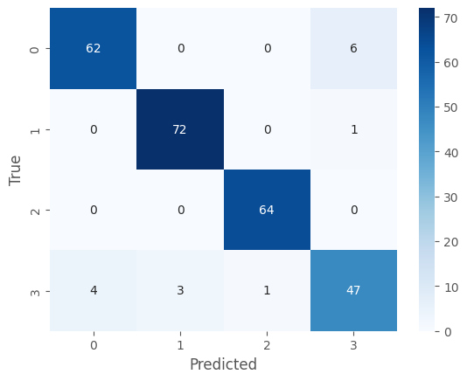
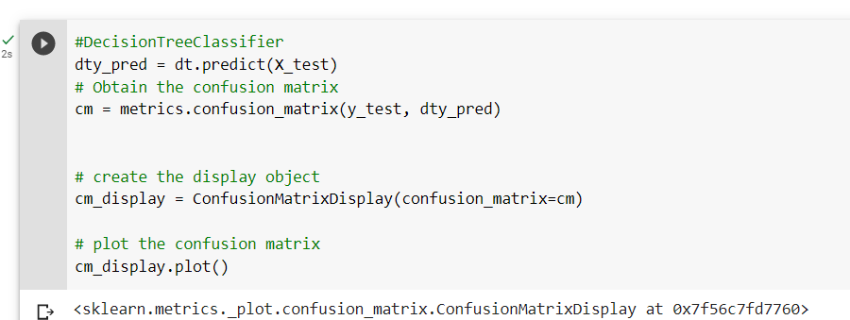
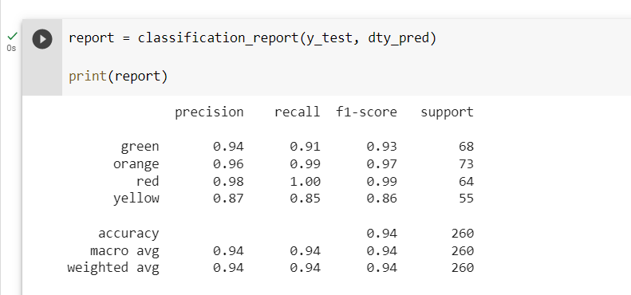
Implementation
Decision Tree Classifier
Confusion matrix
Classification report

Slide 38
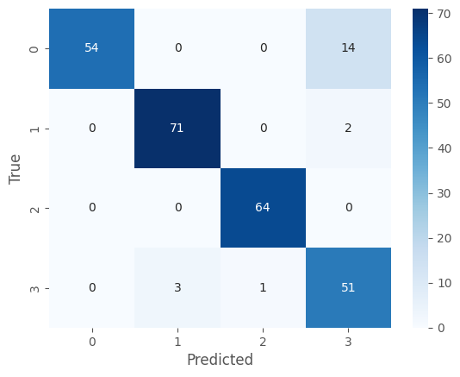
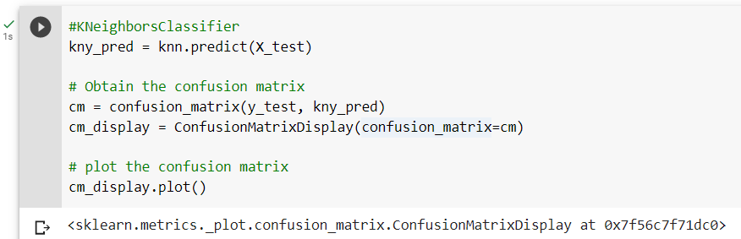
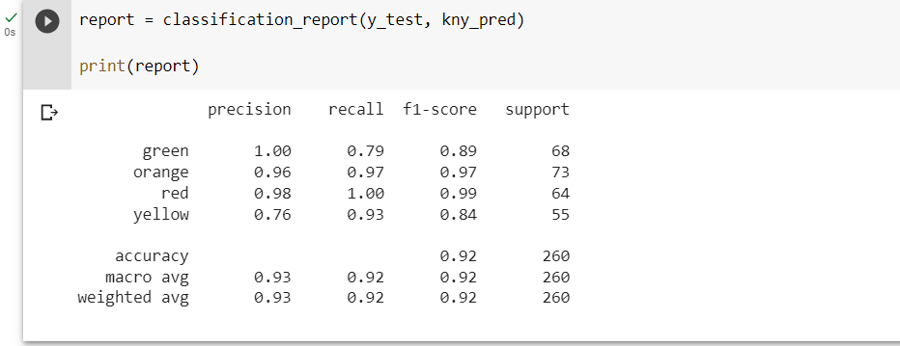
Implementation
KNeighbors Classifier
Confusion matrix
Classification report

Slide 39
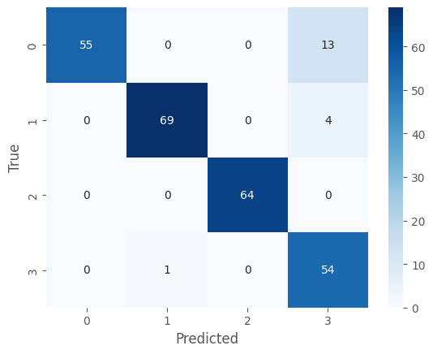
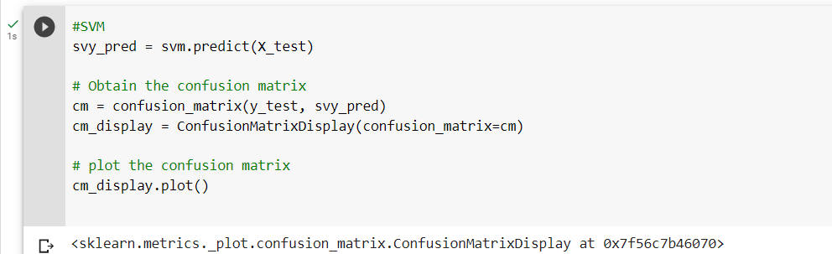
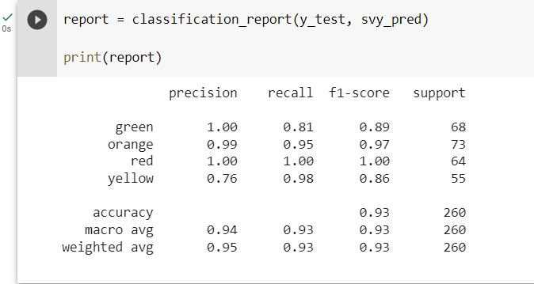
Implementation
Support vector machine(SVM)
Confusion matrix
Classification report

Slide 40
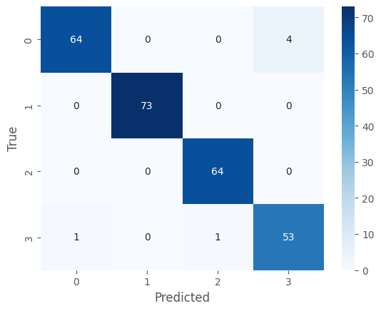
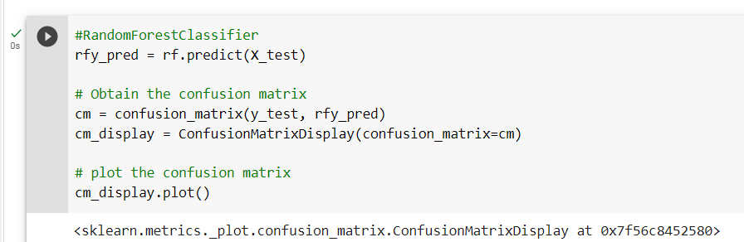
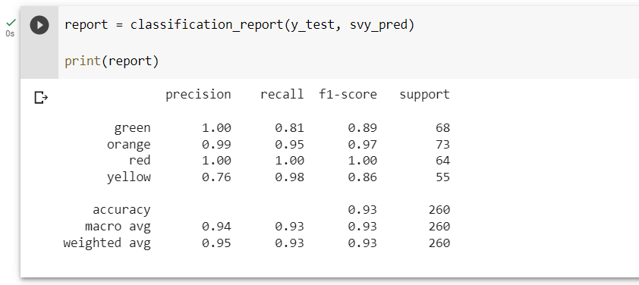
Implementation
Random Forest Classifier
Confusion matrix
Classification Report

Slide 41
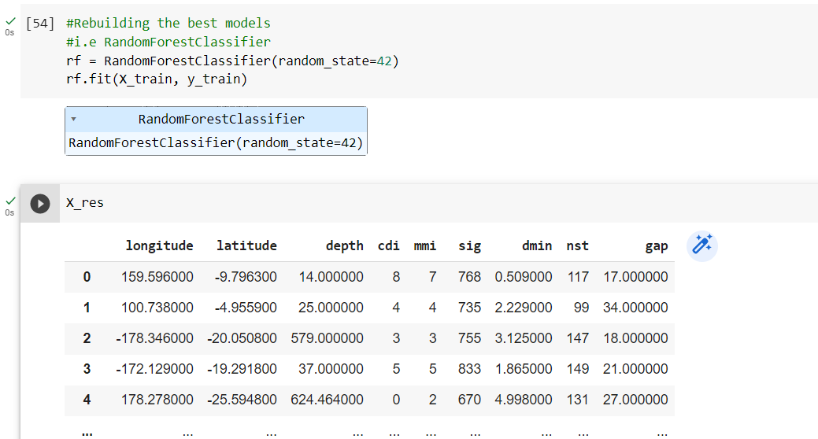
Implementation
Output:
Rebuilding the best Model
--Random Forest Classifier

Slide 42
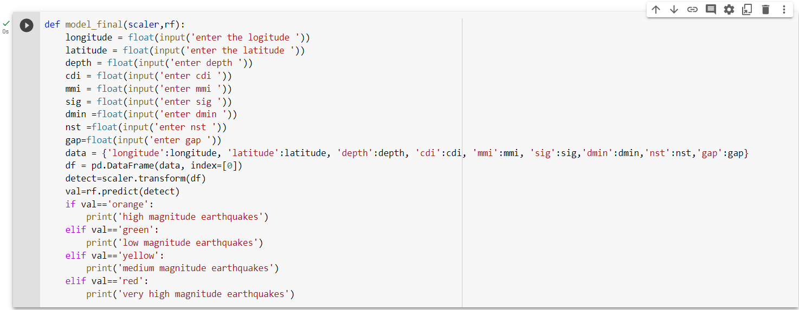
Implementation
Model scalar

Slide 43
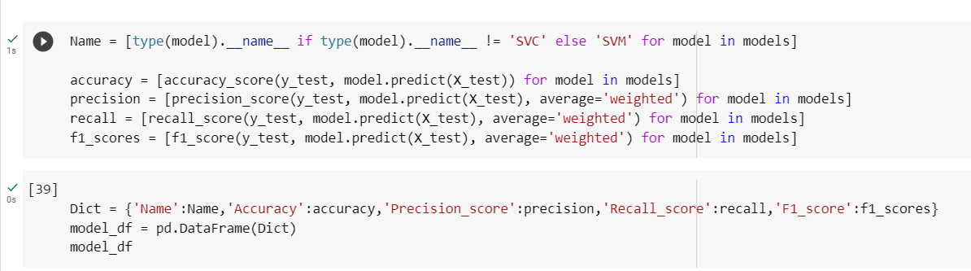
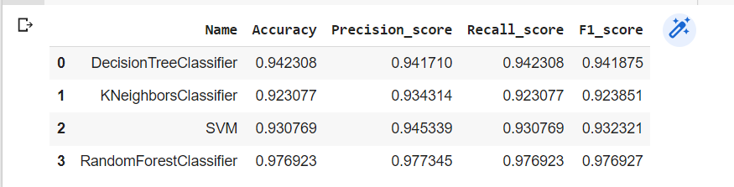
Results
Evaluation of Models

Slide 44
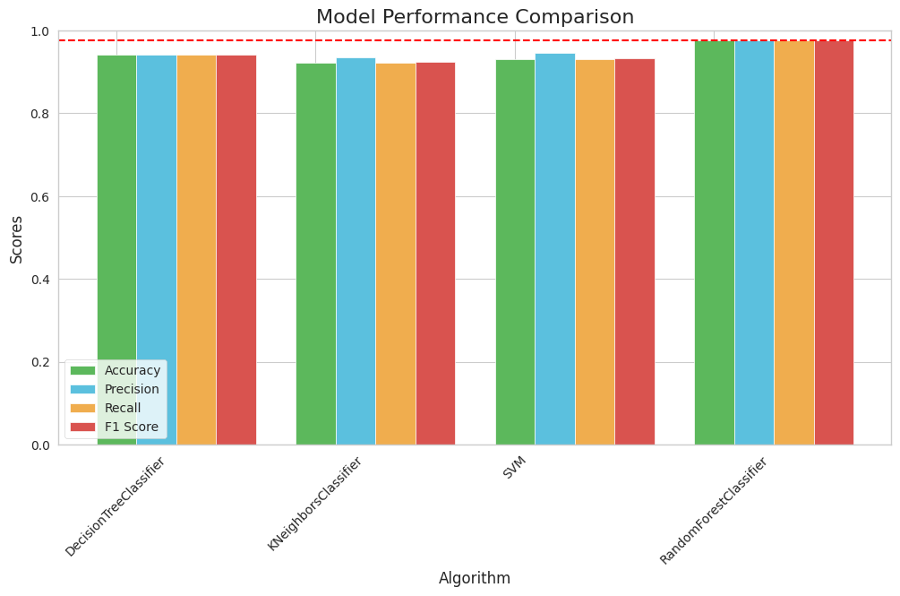
Results

Slide 45
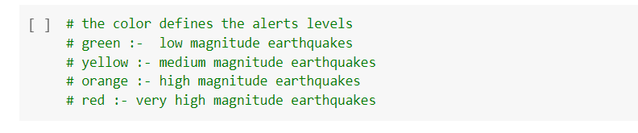
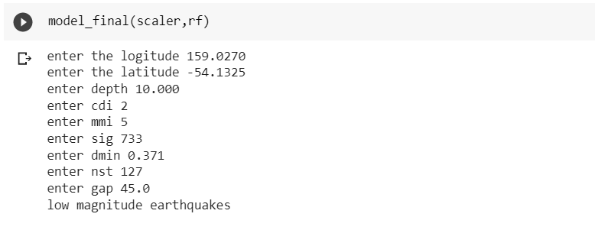
Results
It emphasizes that the use of earthquake detection and random forest algorithms to predict earthquake magnitudes. It suggests that using a random forest algorithm for earthquake detection gives high accuracy, and that prediction can be done using attributes such as longitude, latitude, depth, cdi, mmi, sig, dmin, nst, and gap.

Slide 46
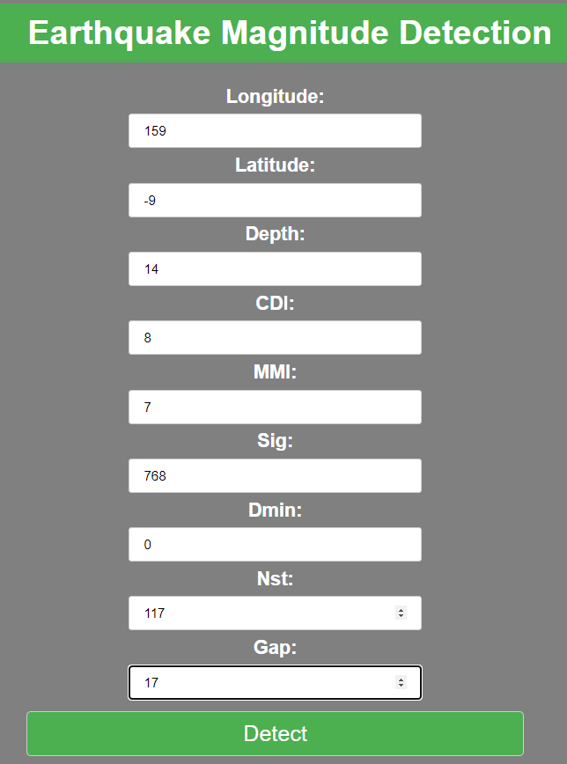
Results
Web app

Slide 47
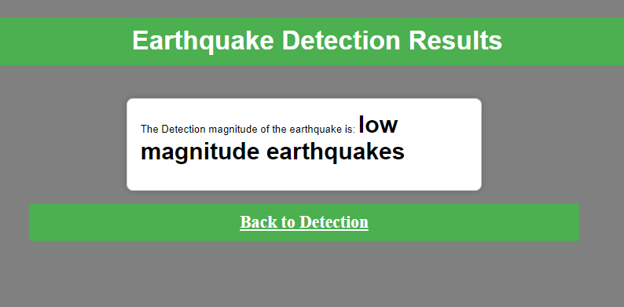
Results
Earthquake detection using webapp UI

Slide 48
Conclusion
Based on the evaluation of four machine learning algorithms, namely Decision Tree Classifier, Kneighbors Classifier, SVC, and Random Forest Classifier, it can be concluded that all models have performed well in detecting earthquakes. Among all the algorithms, the Random Forest Classifier algorithm achieved the highest accuracy score of 0.976923, which is the best performance compared to the other models. The Decision Tree Classifier, Kneighbors Classifier, and SVC algorithms also performed well, with accuracy scores of 0.942308, 0.923077, and 0.930769, respectively.
Moreover, all the models have performed well in terms of precision, recall, and F1-score. These performance metrics are essential for earthquake detection as it requires accurate and reliable predictions to avoid false positives and false negatives. In conclusion, the Random Forest Classifier algorithm is the best model for earthquake detection based on the given dataset. However, other algorithms such as Decision Tree Classifier, K-Neighbour’s Classifier, and SVC can also be used as they have also shown good performance.

Slide 49

Acknowledgement
Fig : Acceptance Notification

Slide 50
Research Paper
The Cavalcade of Immaculate and Disparate Algorithms for Detecting Distracted Earthquakes Employing Machine Learning.

Slide 51


Certificates

Slide 52


Certificates

Slide 53
References
[1]A. G. Hafez, A. A. Azim, M. S. Soliman, and H. Yayama, “Realtime P-wavepicking for earthquake early warning system using discrete wavelet transform,” NRIAG J. Astron. Geophys., vol. 9, no. 1, pp. 1–6, Jan. 2020.
[2]A. Lomax, A. Michelini, and D. Josipovic’s, “An investigation of rapid earthquake characterization using single-station waveforms and a convolutional neural network,” Seismol. Res. Lett., vol. 90, no. 2A, pp. 517–529, Mar. 2019.
[3]Omar M. Saad, Ali G. Hafez, and M. Sami Soliman, “Deep Learning Approach for Earthquake Parameters Classification in Earthquake Early Warning System” 1545- 598X © 2020 IEEE.
[4]Hang Zhang 1 2, Jun Zeng 1, Chunchi Ma 1 3, Tianbin Li 1, Yelin Deng 1, Tao Song “Multi-Classification of Complex micro seismic Waveforms Using Convolutional Neural Network: A Case Study in Tunnel Engineering” Sensors 2021, 21(20), 6762.
[5]Khawaja Asim, Abdul Basit-“Earthquake magnitude Detection in Hindukush region using Machine Learning techniques” pp.1-17, 2017.

Slide 54
[6]Dr. S. Anbu Kumar1, Abhay Kumar2, Aditya Dhanraj3, Ashish Thakur, Earthquake Prediction using Machine Learning, ISO 9001:2008 Certified Journal, International Research Journal of Engineering and Technology (IRJET), Issue: 05 | May 2021.
[7] Roxane Mallouhy, Chady Abou Jaoude ,Christophe Guyeu, Abdallah Makhoul, Major earthquake event prediction using various machine learning and author profiles for this publication at: https://www.researchgate.net/publication/339901560.
[8] Alyona Galkina, Natalia Grafeeva, Machine Learning Methods for Earthquake Prediction: a Survey,CEUR –ws.org/vpl-2372/SEIM_2019_paper_31.
[9] Dinky Tulsi Nandwani, 2Vanita Buradka, EARTHQUAKE DAMAGE PREDICTION USING MACHINE LEARNING, © 2022 IJCRT | Volume 10, Issue 7 July 2022 | ISSN: 2320-288, www.ijcrt.org.
[10] Rabia Tehseen, Muhammad Shoaib Farooq * and Adnan Abid, Earthquake Prediction Using Expert Systems: A Systematic Mapping Study, Received: 24 December 2019; Accepted: 15 March 2020; Published: 19 March 2020.

Slide 55
Thank You!!!

